Slide 1
Learning Objective
I will be able to solve trigonometric equations
Success Criteria
At the end of the lesson, I will be able to:
recall the graphing of trigonometric functions;
use the graph of a trigonometric functions to solve a simple equation by looking for intersection points;
recall the exact values and reference angles in a unit circle to generate the values;
solve trigonometric equations over a given domain, using the reference angle method;
recognise that a change in period represents a change in domain when solving a trigonometric equation; and
solve trigonometric equations graphically or using the CAS ClassPad.

Slide 2
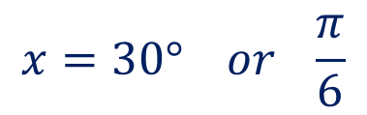
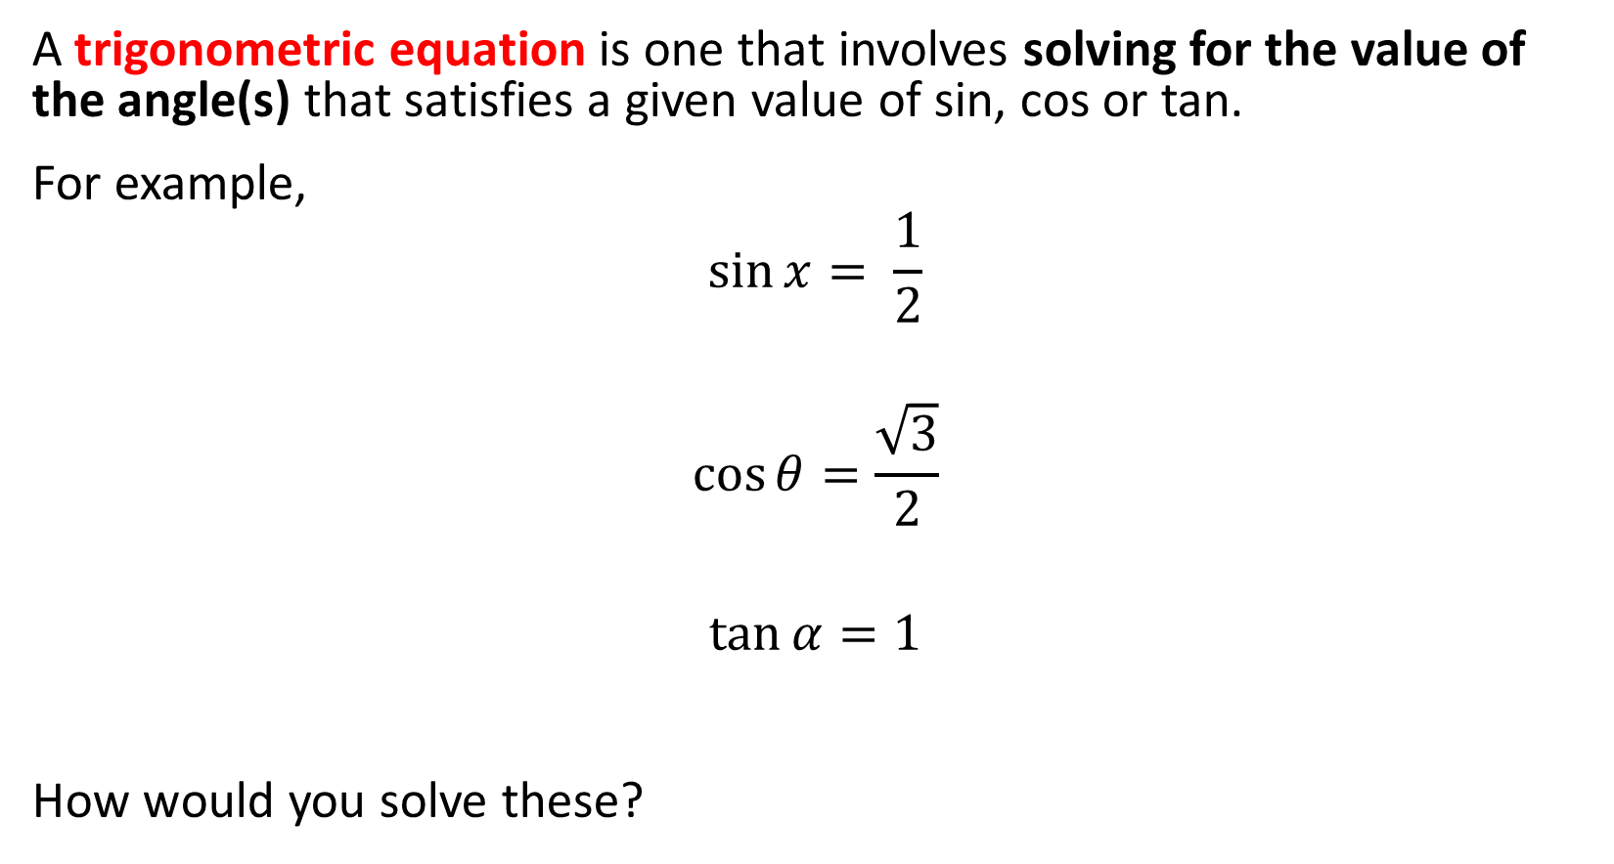
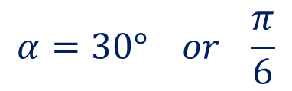
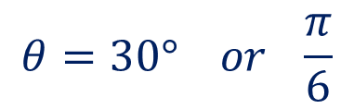
Trigonometric Equations
Concept Development
A trigonometric equation is one that involves solving for the value of the angle(s) that satisfies a given value of sin, cos or tan.
For example,
$$\sin{x= \frac{1}{2}}$$
$$\cos{θ=\frac{\sqrt{3}}{2}}$$
$$\tan{α}=1$$
How would you solve these?
$$x=30° or \frac{π}{6}$$
$$θ=30° or \frac{π}{6}$$
$$α=30° or \frac{π}{6}$$

Slide 3
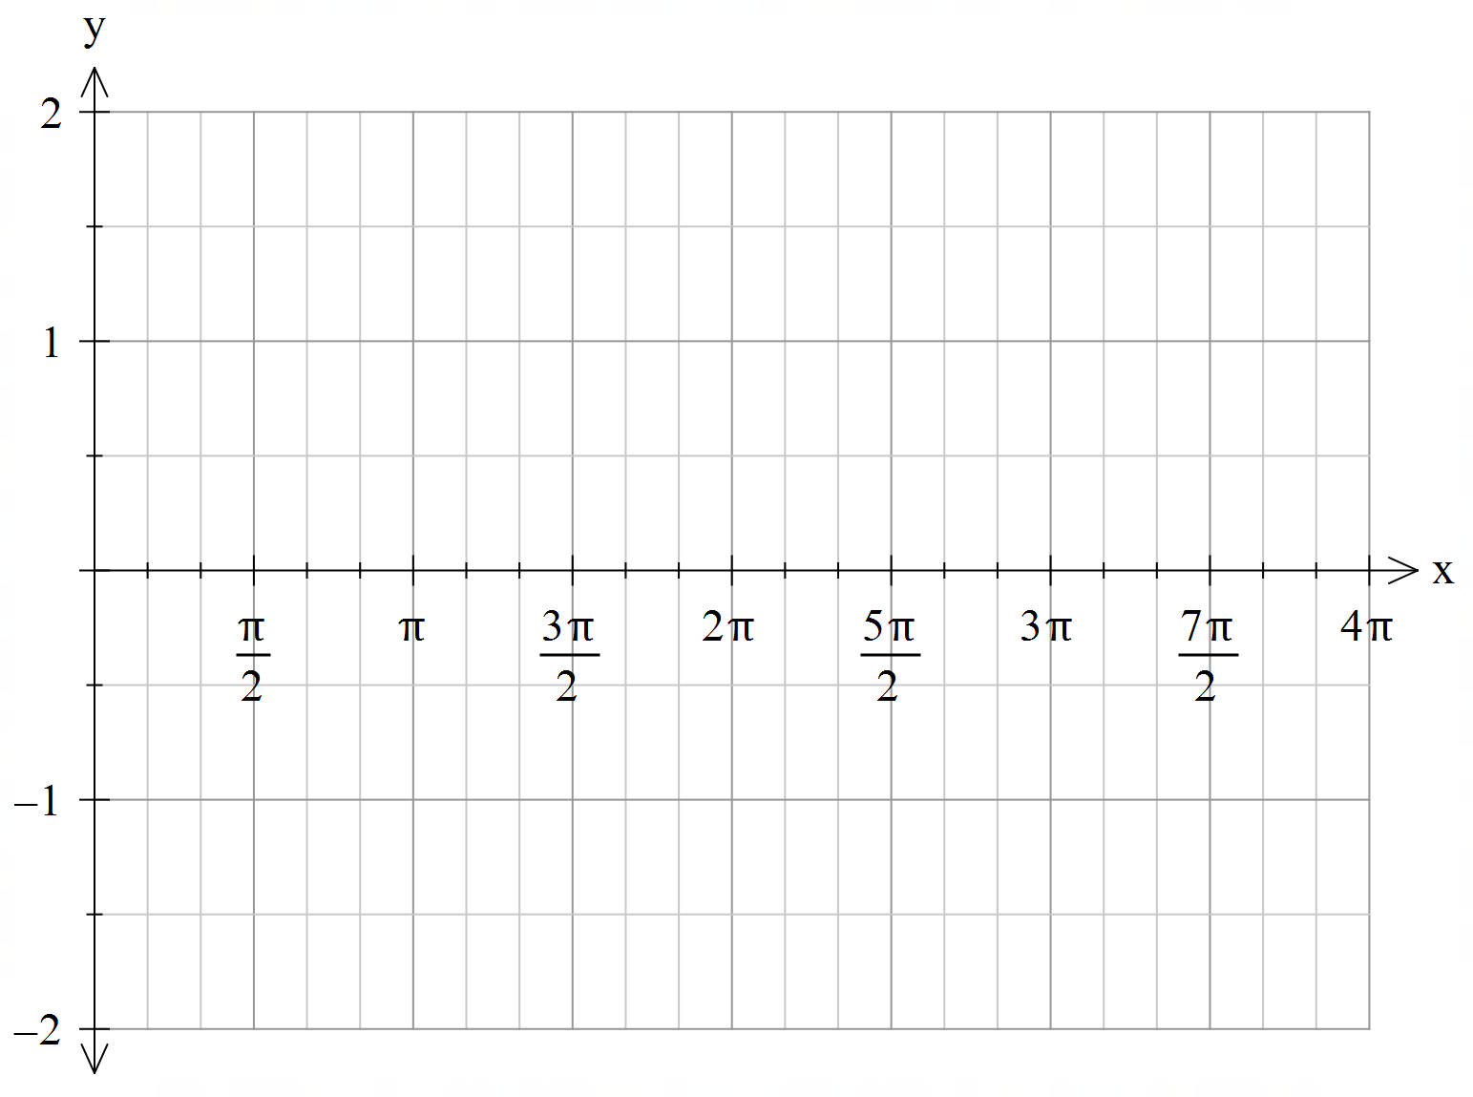
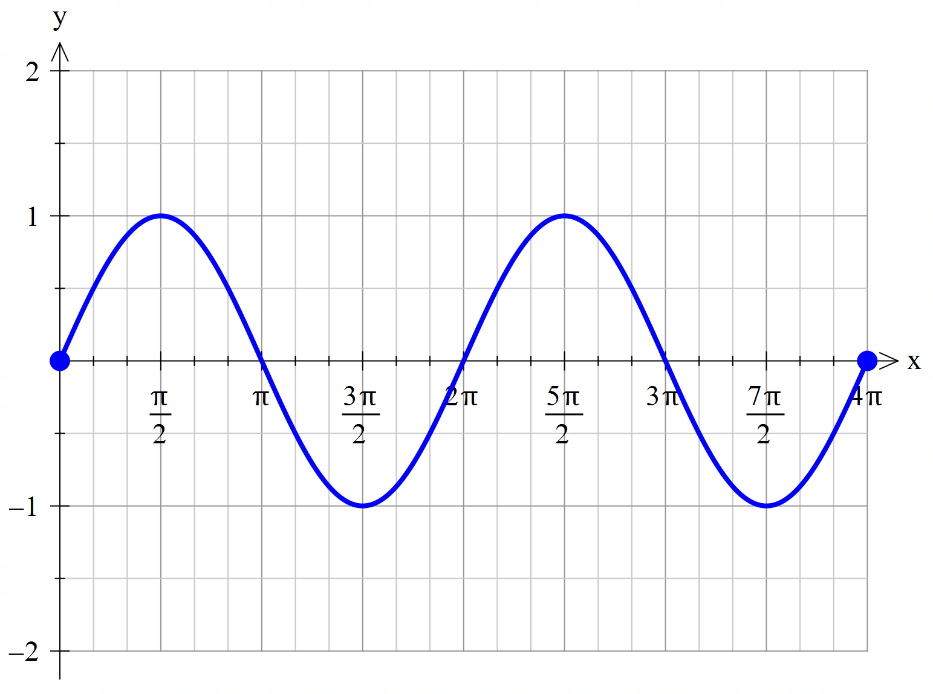

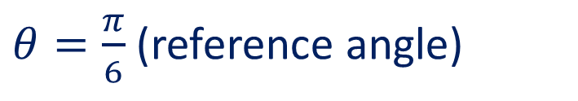
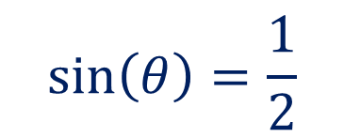
Find all the solutions to the equation $\sin\left(θ\right)=\frac{1}{2}$for $θ∈[0,4π]$.
Guided Practice
$$\sin\left(θ\right)=\frac{1}{2}$$
$θ=\frac{π}{6}$ (reference angle)
From the graph, there are 3 other solutions.

Slide 4

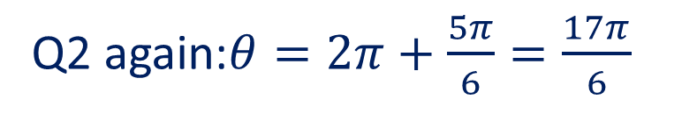


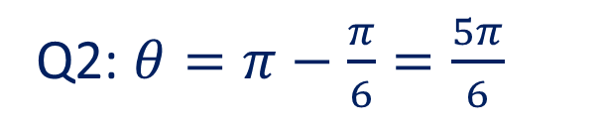

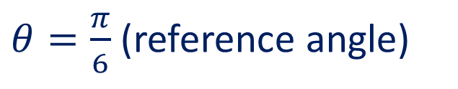

Find all the solutions to the equation $\sin\left(θ\right)=\frac{1}{2}$for $θ∈[0,4π]$.
Guided Practice
$$y$$
$$\sin\left(θ\right)=\frac{1}{2}$$
Quadrant 2
Quadrant 1
$$\left(\frac{\sqrt{3}}{2},\frac{1}{2}\right)$$
$θ=\frac{π}{6}$ (reference angle)
$$\frac{π}{6}$$
Q2: $θ=π−\frac{π}{6}=\frac{5π}{6}$
0
$$x$$
Q1 again:$θ=2π+\frac{π}{6}=\frac{13π}{6}$
Q2 again:$θ=2π+\frac{5π}{6}=\frac{17π}{6}$
Quadrant 3
Quadrant 4

Slide 5
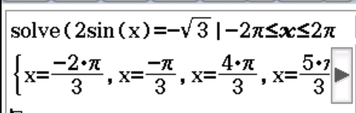

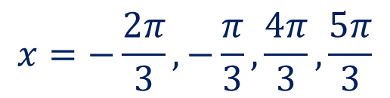





: Solve the following trigonometric equations
Guided Practice
$\cos{θ}=\frac{1}{2}$ for $0≤θ≤360°$
$\tan{θ}=\sqrt{3}$ for $0≤θ≤540°$
$2\sin\left(x\right)=−\sqrt{3}$ for $−2π≤x≤2π$
$$θ=60° , 300°$$
$$θ=60° , 240°. 420°$$
$$\sin\left(x\right)=−\frac{\sqrt{3}}{2}$$
$$x=−\frac{2π}{3},−\frac{π}{3},\frac{4π}{3},\frac{5π}{3}$$

Slide 6
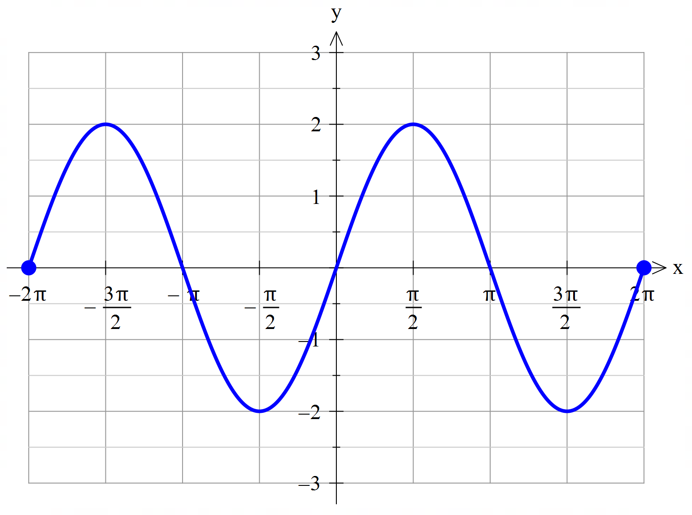





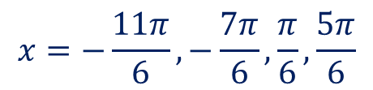

Solve the following trigonometric equations over the domain - 2𝝅 ≤ x ≤ 2𝝅.
Guided Practice
$$2sin⁡(x) = 0$$
$$2sin⁡(x) = −2$$
$$2sin⁡(x) = 1$$
$$\sin\left(x\right)=0$$
$$x=−2π,−π,0,π,2π$$
$$\sin\left(x\right)=−1$$
$$x=−\frac{π}{2},\frac{3π}{2}$$
$$\sin\left(x\right)=\frac{1}{2}$$
$$x=−\frac{11π}{6},−\frac{7π}{6},\frac{π}{6},\frac{5π}{6}$$

Slide 7
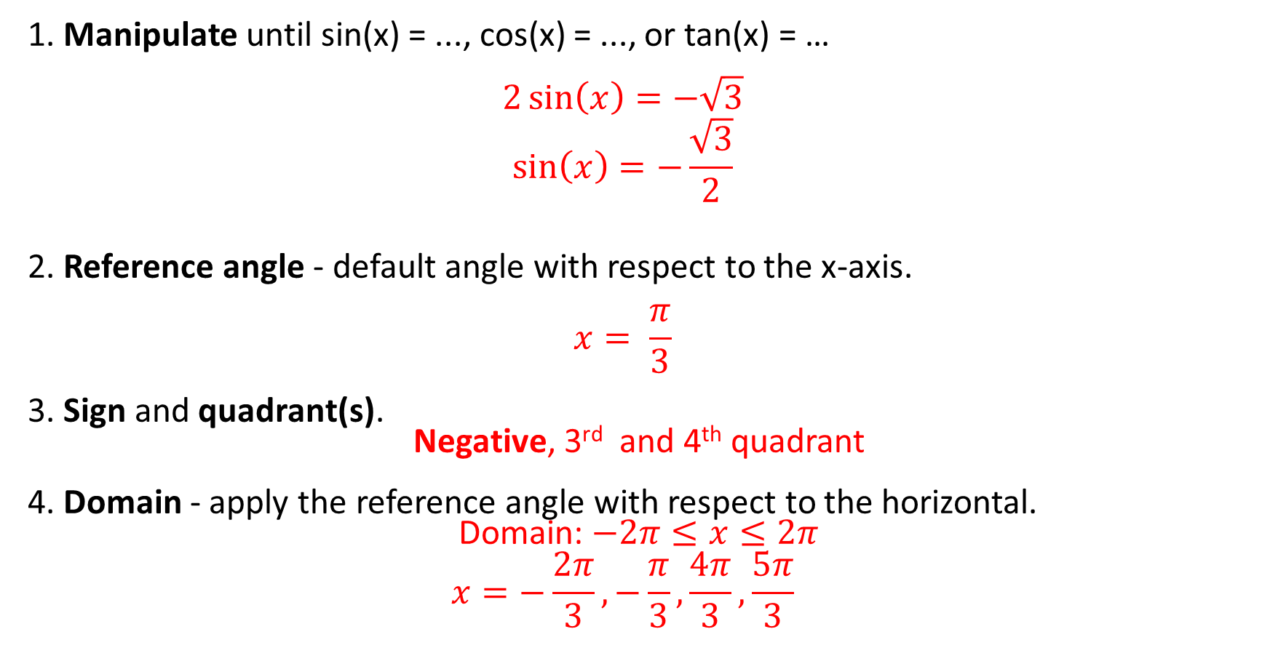
Suggested Method
Concept Development
1. Manipulate until sin(x) = ..., cos(x) = ..., or tan(x) = … $$2\sin\left(x\right)=−\sqrt{3}$$
$$\sin\left(x\right)=−\frac{\sqrt{3}}{2}$$
2. Reference angle - default angle with respect to the x-axis. $$x= \frac{π}{3}$$
3. Sign and quadrant(s).
Negative, 3rd and 4th quadrant
4. Domain - apply the reference angle with respect to the horizontal.
Domain: $−2π≤x≤2π$
$$x=−\frac{2π}{3},−\frac{π}{3},\frac{4π}{3},\frac{5π}{3}$$

Slide 8
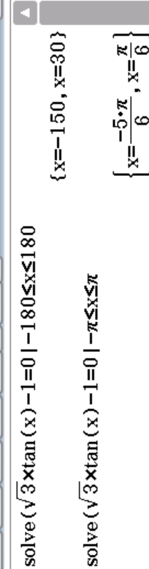

Solving using the CAS ClassPad
Main
Check Deg or Rad
Solve
Enter in equation, Change Lower and Upper to the given domain.
Concept Development

Slide 9
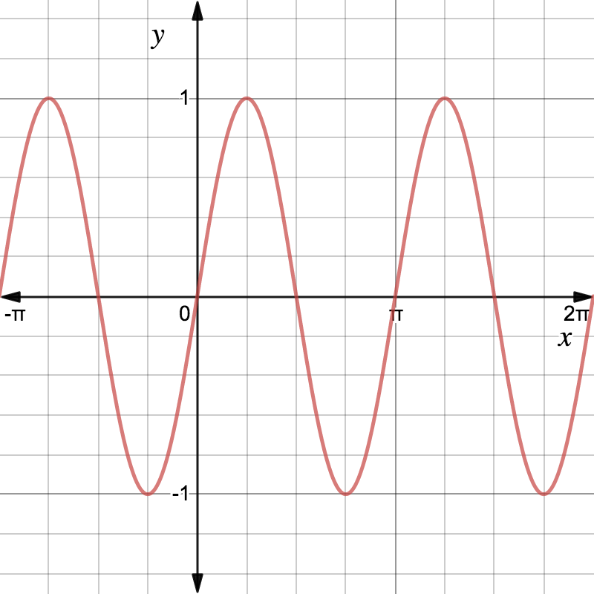
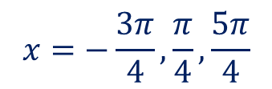
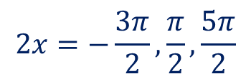
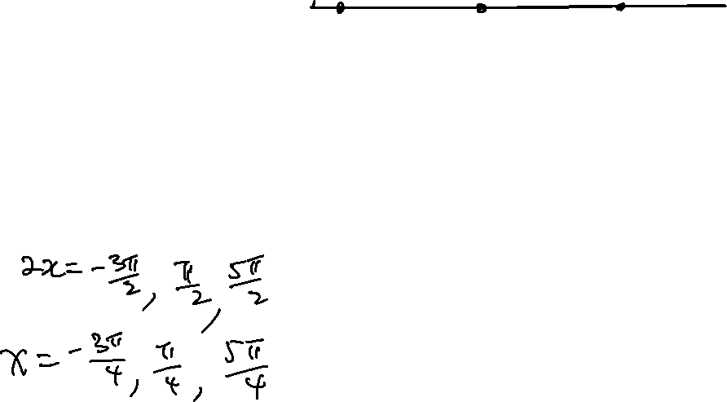
Changing Domains
Concept Development
When solving a trigonometric equation that has a change in period, we must take into account a effect on the given domain.
Consider the graph of y = sin(2x).
Solve, graphically,
sin(2x) = 1, -𝜋 ≤ x ≤ 2𝜋
$$2x=−\frac{3π}{2},\frac{π}{2},\frac{5π}{2}$$
$$x=−\frac{3π}{4},\frac{π}{4},\frac{5π}{4}$$

Slide 10





Solve the following trigonometric equation (algebraically).
Guided Practice
SUGGESTED METHOD:
Manipulate until sin(bx) = ..., cos(bx) = ..., or tan(bx) = …
Reference angle - default angle with respect to the x-axis.
NEW DOMAIN - modify to suit the period change.
Sign and Quadrant(s).
Solve - within OLD DOMAIN.
$$sin⁡(2x) = 1, −π ≤ x ≤ 2π$$
Multiply domain by 2
New domain:$−2π≤2x≤4π$
$$\sin{(2x)}=1$$
$2x=\frac{π}{2}$ (Reference angle)
$2x=−\frac{3π}{2},\frac{π}{2},\frac{5π}{2}$
$x=−\frac{3π}{4},\frac{π}{4},\frac{5π}{4}$

Slide 11
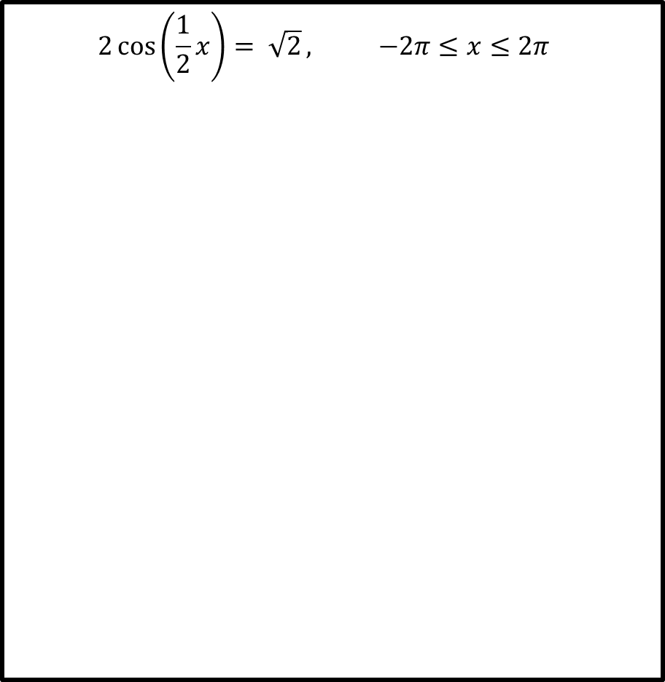

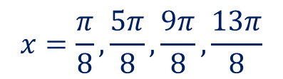






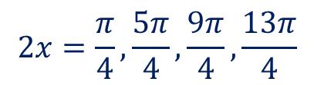



Solve the following trigonometric equations.
Guided Practice
$$2\cos\left(\frac{1}{2}x\right)= \sqrt{2}, −2π≤x≤2π$$
$$\tan{(2x)}=1, 0≤x≤2π$$
$$\tan\left(2x\right)=1$$
$$0≤2x≤4π$$
$$\cos\left(\frac{1}{2}x\right)=\frac{\sqrt{2}}{2}$$
$$−π≤\frac{x}{2}≤π$$
Reference angle, $2x=\frac{π}{4}$
Reference angle, $\frac{1}{2}x=\frac{π}{4}$
$$\frac{1}{2}x=−\frac{π}{4},\frac{π}{4}$$
$$x=−\frac{π}{2},\frac{π}{2}$$
$$2x=\frac{π}{4},\frac{5π}{4},\frac{9π}{4},\frac{13π}{4}$$
$$x=\frac{π}{8},\frac{5π}{8},\frac{9π}{8},\frac{13π}{8}$$

Slide 12
Independent Practice
Complete Cambridge Ex 12H

